Slide 1
MPP Test Automation Tool

Slide 2
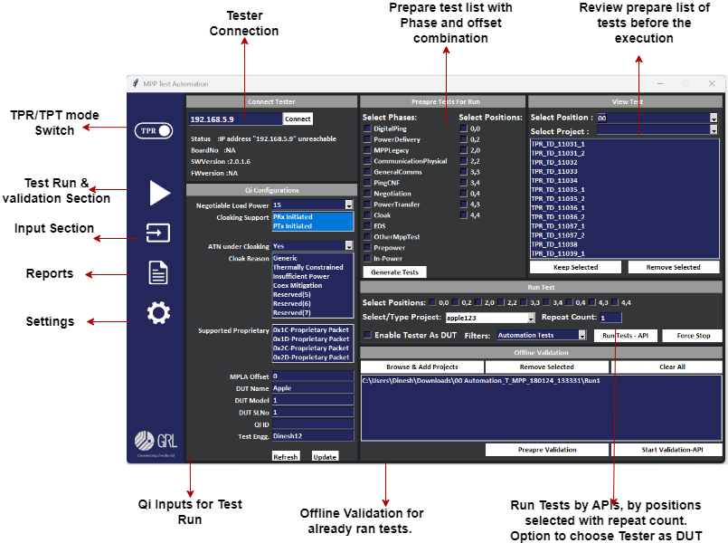
Tool Overview

Slide 3
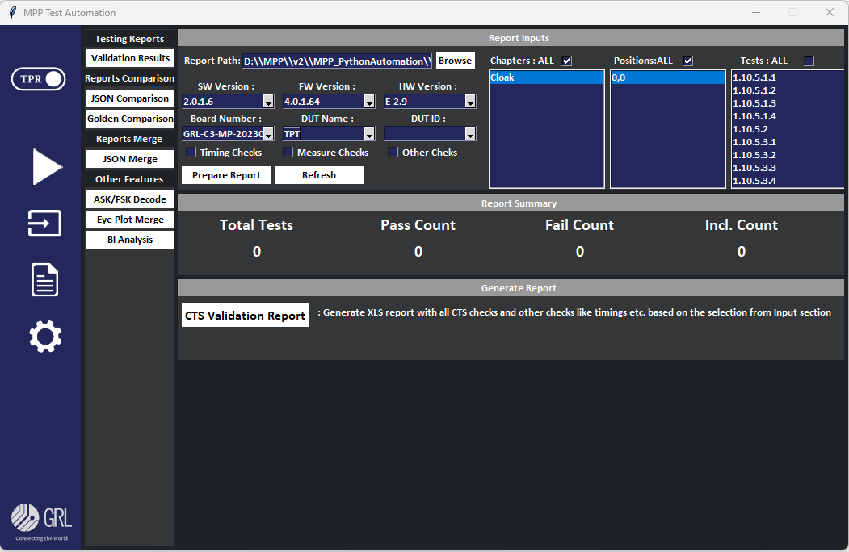
Report Module

Slide 4
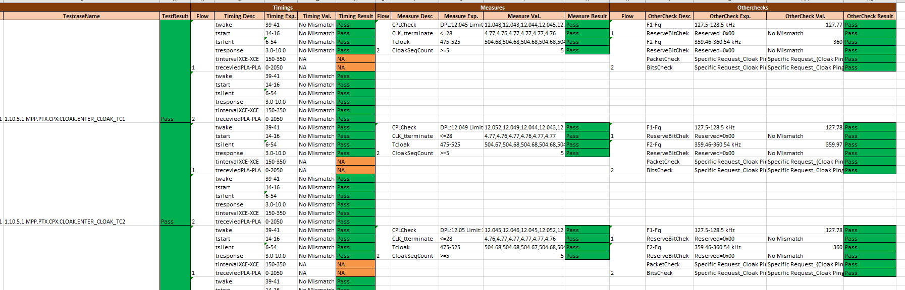
Report Features
Testing Reports :
CTS validation Report with all Timings checks, plot measures and other standard checks.

Slide 5
Other Reports & Features
MPP final JSON files merge automatically based on the results from different run
Offline comparison : High level validation results can be compared with the golden DUT results.
stability check : If test has more runs, each run results and run time will be plotted in the report for the better comparison.
ASK/FSK Decode Issue checks.
Eye plot merge into single Excel file for the comparison.
BI Analysis for MPLA calibrated testers.

Slide 6
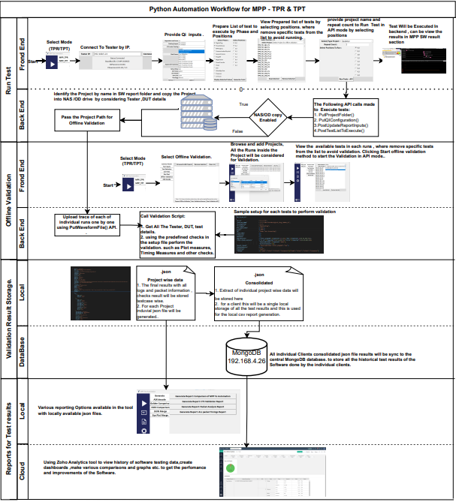
Working Flow

